Slide 1
An Analysis of News Headlines
Noah Minshew
MIS 670

Slide 2
Introduction
News headlines can make a huge impact on the success of an article and ultimately the outlet
A lot of readers skim headlines to either gather the information they want or find articles they would like to read
What can we find if we explore headlines from the top news outlets in the United States?

Slide 3
Business Questions
How are events portrayed/framed by different news sources?
Do news headlines tend to be positive or negative? Why?
What are the most popular topics across all top news outlets in the US?
How do outlets use headlines to attract certain types of readers? (Liberal/Conservative)
What is the overall sentiment of news headlines in the United States? Why?

Slide 4
Value of Analysis
Benefits:
Learn how events/topics are reported by all of the top news outlets in the US
Learn how to frame a topic to best reach certain audiences
Find ways to attract new audiences
Potential Clients
New news outlets looking for insight on how to best name their articles
Consumers that want to understand why outlets use certain language in their headlines

Slide 5
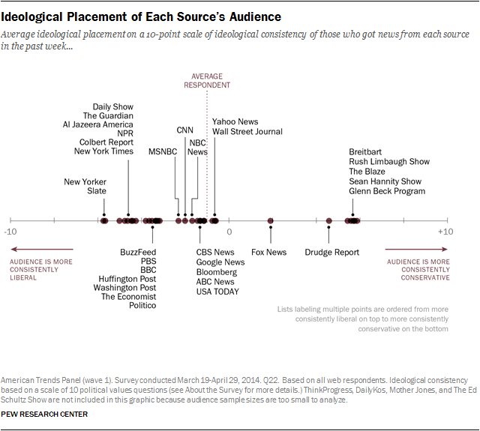
Data Source
https://newsapi.org/
This API provides a way to query news articles from over 30,000 sources
I selected a total of 10 news sources
We want an equal balance of conservative and liberal news sources:
The pew research center published an article on the ideological placement of News Source’s Audience
Reference: http://www.journalism.org/2014/10/21/political-polarization-media-habits/pj_14-10-21_mediapolarization-08/

Slide 6
Data Source
https://newsapi.org/
This API provides a way to query news articles from over 30,000 sources
I selected a total of 10 news sources
We want an equal balance of conservative and liberal news sources:
The pew research center published an article on the ideological placement of News Source’s Audience
Reference: http://www.journalism.org/2014/10/21/political-polarization-media-habits/pj_14-10-21_mediapolarization-08/
Conservative: breitbart-news, fox-news, national-review, the-american-conservative, the-washington-times
Liberal: cnn, the-new-york-times, the-washington-post, the-huffington-post, msnbc

Slide 7

Part 1: Data Collection
https://github.com/nminshew5/MIS670FinalProject/blob/master/Minshew_N_Final_Project_Part1.ipynb

Slide 8
Part 2: Descriptive Analytics & Sentiment Analysis
https://github.com/nminshew5/MIS670FinalProject/blob/master/Minshew_N_Final_Project_Part2_DescriptiveAnalytics%26Sentiment.ipynb
https://cdn.rawgit.com/nminshew5/MIS670FinalProject/e2a2c1d4/MIS670FinalProject_Seniment_RNotebook.html

Slide 9
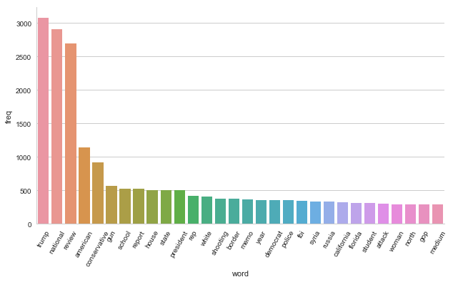
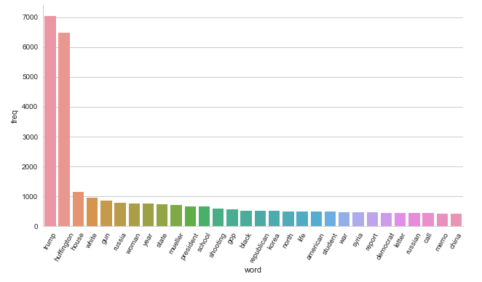
Word Frequency of Headlines
Conservative Headlines
Liberal Headlines

Slide 10
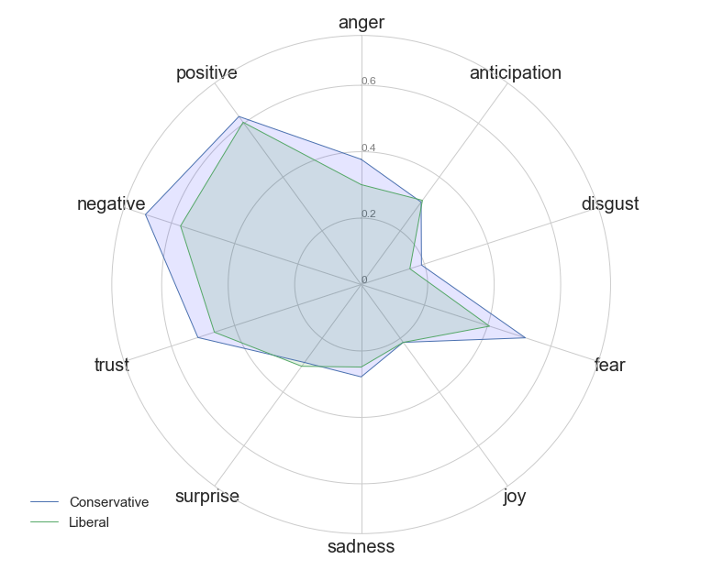
Sentiment Analysis Liberal vs Conservative
This graph is interesting because it shows that conservative sources seem to have more emotion in general than liberal news sources
Liberal news headlines have a higher amount of surprise and anticipation than conservative news headlines
Conservative news headlines are much more negative; they have more fear, sadness, disgust, and anger related words

Slide 11
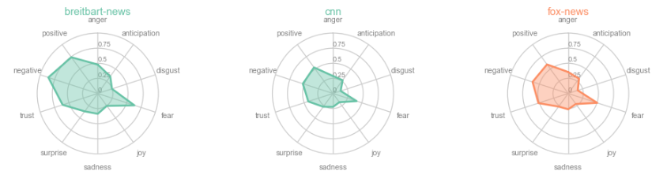
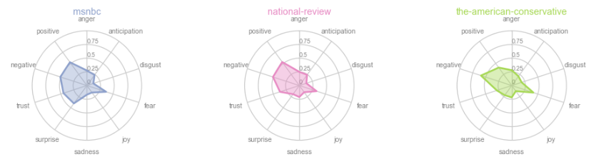
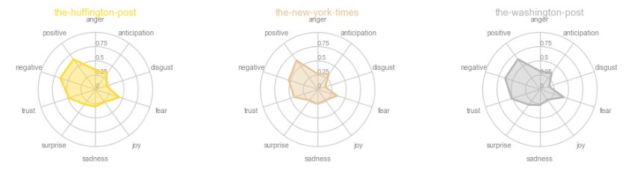
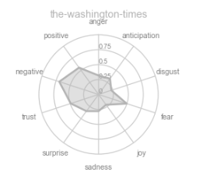
Sentiment Analysis
Breitbart news seems to be an outlier. They use they most emotion in their headlines.
Could this indicate they are attempting to click bait readers?
The American Conservative uses the least amount of emotion in their headlines.
The larger outlets seem to use less emotion than smaller news sources
This could be an attempt to get more readers by the small outlets

Slide 12
Part 3: Topic Modeling
Topic Model with 20 topics:
0: bill, john, former, senate, race, without, spending, attorney, bolton, wins
1: trump, state, comey, gets, obama, union, republican, james, makes, legal
2: trump, deal, students, control, fight, violence, military, star, iran, full
3: america, trump, still, book, immigration, story, power, free, speech, possible
4: case, amid, officials, abuse, second, goes, ever, problem, debate, past
5: media, team, dies, talks, stop, game, love, interview, teacher, sessions
6: trump, stormy, daniels, stormy_daniels, cohen, michael, lawyer, help, michael_cohen, democratic
7: trump, russian, teachers, official, attacks, night, word, rights, despite, strike
8: death, video, shows, another, anti, judge, policy, nationals, care, wednesday
9: women, china, world, latest, dead, olympic, found, accused, clinton, three
10: russia, trump, memo, republicans, nunes, real, super, attack, fire, made
11: trump, president, black, donald, donald_trump, trade, democrats, campaign, putin, plan
12: mueller, trump, life, morning, probe, even, question, mccabe, firing, tweets
13: pruitt, history, americans, change, scott, ryan, paul, lives, support, meet
14: house, white, white_house, trump, election, chief, security, meeting, porter, kelly
15: year, woman, letter, family, kids, home, country, pompeo, vote, february
16: north, korea, north_korea, california, south, city, inside, pence, suspect, korean
17: shooting, florida, school, facebook, parkland, calls, best, olympics, political, student
18: wants, guns, watch, police, killed, takes, call, work, justice, pennsylvania
19: court, syria, million, zuckerberg, live, lead, mark, congress, behind, lawmakers

Slide 13
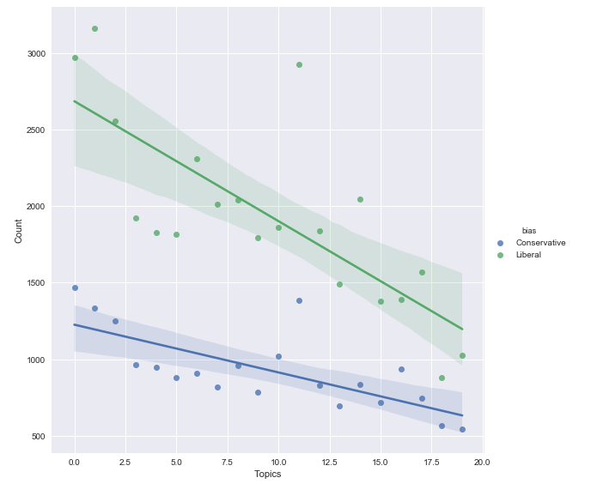
Topic By Political Bias
Conservatives reported heavily on these topics:
Topic 0: John Bolton the new secretary of defense.
Topic 11: Trump and Putin connections
Topic 16 North Korea
Liberals reported Heavily on topics:
Topic 1: Trump and James Comey (the former FBI director Trump fired)
Topic 14: Rob Porter a Trump advisor who was accused of domestic abuse

Slide 14
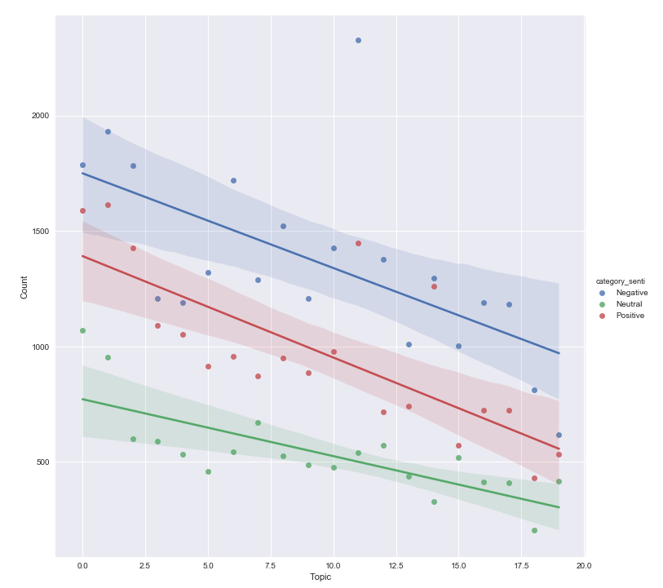
Topic By Sentiment
Topic 11: Has an outlier with negative sentiment. This topic was about Donald Trumps campaign. This has been a hot topic and the media likes to portray it in a very negative sense
Topic 1: This has the most positive sentiment. This has to do with James Comey (former FBI director)

Slide 15
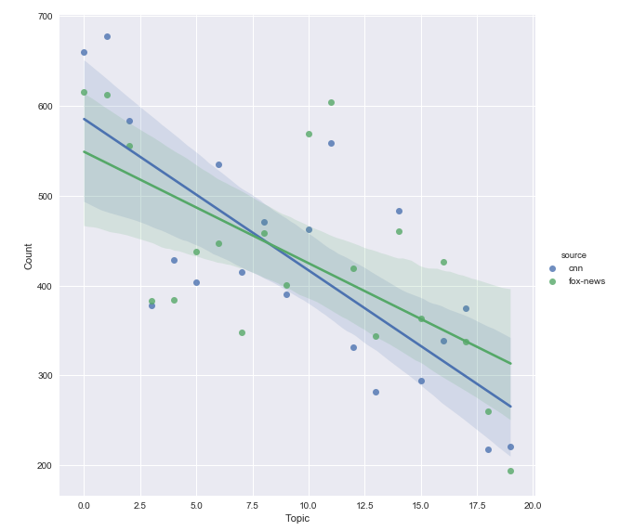
Fox vs CNN Topics
How do the two biggest sources on each side compare?
The spread is almost equal on each topic here
The largest spread are on:
Topic 6: Stormy Daniels Controversy
Topic 10: Trump Russia Investigation
Fox reported less on each of these topics

Slide 16
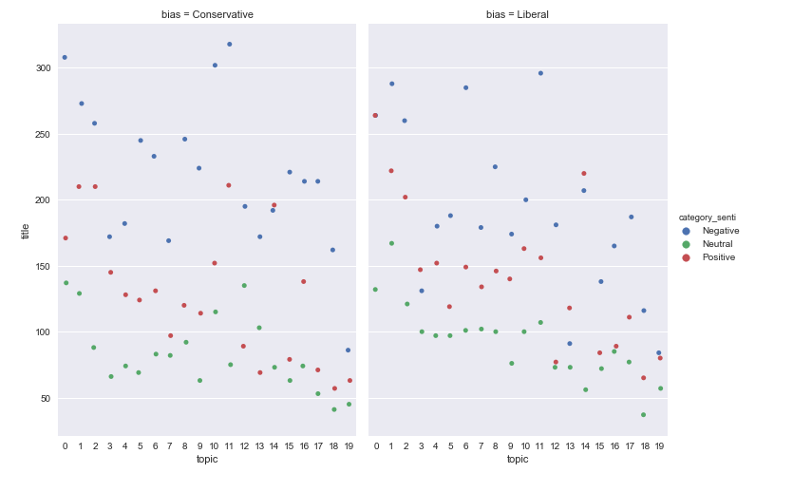
Topic Sentiment By Bias
The conservative news sources tend to be more negative in general than liberal news sources
The spread between positive and negative is much larger in conservative news. Does this indicate that the liber sources are more objective?

Slide 17
Conclusions
Overall, news headlines tend to be negative.
This may be because negativity, fear, disgust, and anger grab peoples attention.
Generally, conservative news sources are more negative than liberal news sources
There are more liberal news sources than conservative news sources.
News sources report more on topics that favor their political bias
The smaller news sources used more emotion in their headlines than larger news sources
This could be an attempt to gain new viewers

